Slide 1
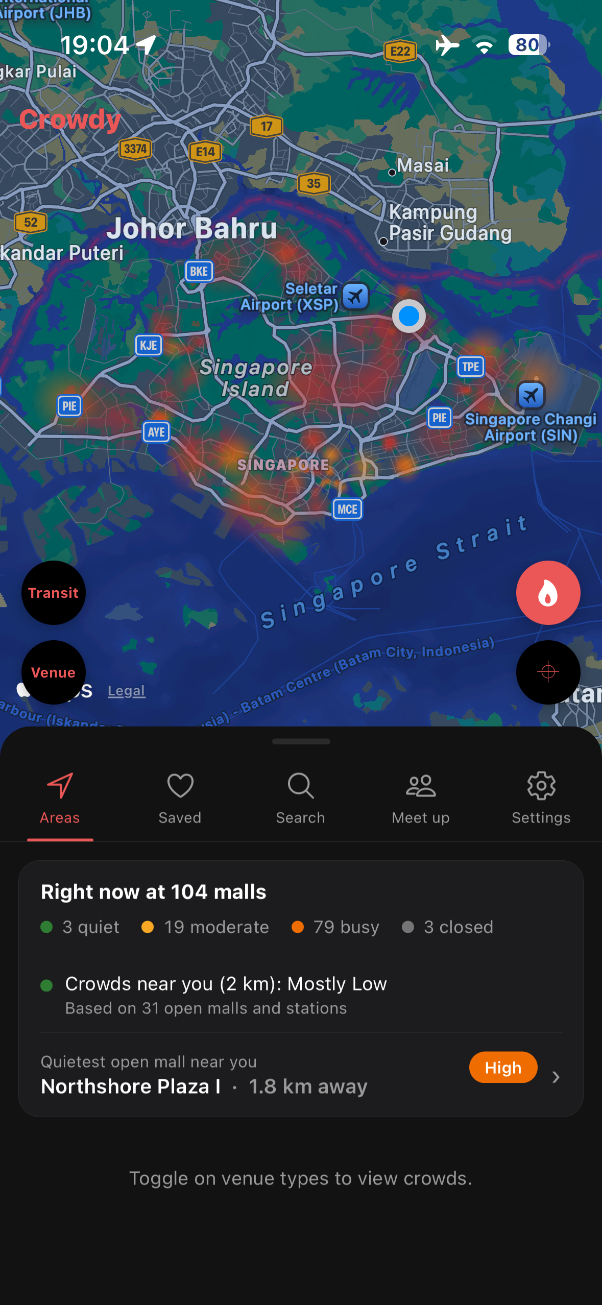
Crowdy
SC2006 SOFTWARE ENGINEERING · DEMO
Check how crowded Singapore’s malls and transit stations are,
and find places for friends to meet.
SCSJ Group 3
Tan Leong Jun Joseph · Teo Kok Wei, Oscar · Mao Yikai · Xu Hanwen · K Eswaran
Notes:
“Hi, we’re Group 3, and this is Crowdy, an iOS app that shows how crowded Singapore’s malls and MRT stations are, and find recommended places for friends to meet.”
“In the next few minutes, I’ll showcase the app and explain the software engineering principles behind each part together as it comes up.”

Slide 2
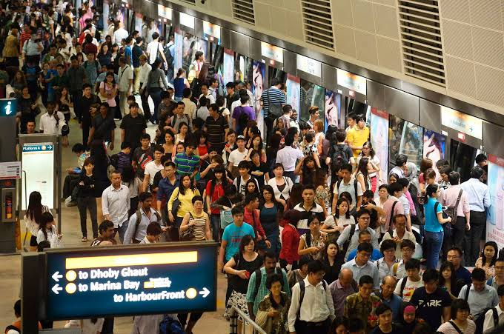


You only find out a place is packed when you get there
THE PROBLEM
Crowdy shows how busy 104 malls and every MRT/LRT station are, suggests quieter places nearby, and helps friends pick a fair place to meet.
LTA DataMall
Live crowd level at every station, every 5 minutes
Google Popular Times
Each mall’s typical week, hour by hour, and its opening hours
OneMap
Routes and travel times for directions and meetups
Individually, none of these sources answer: "Where should we go that isn't crowded?"
Crowdy merges them to ease an everyday annoyance in the small bustling city of Singapore.
Notes:
“Well, the problem is simple. You usually only find out a place is packed once you’re already there.”
“Crowdy shows how busy it is for 104 malls and every transit station in the country. It then suggests quieter places nearby, and help a group of friends pick a mall that’s fair for everyone to reach.”
“It builds on three free data sources: LTA DataMall for live station crowds every five minutes, Google Popular Times for each mall’s typical week and opening hours, and OneMap for routes and travel times.”
"Individually, none of these sources answer: "Where should we go that isn't crowded?"
"So, Crowdy merges them to ease an everyday annoyance in the small bustling city state of Singapore."

Slide 3

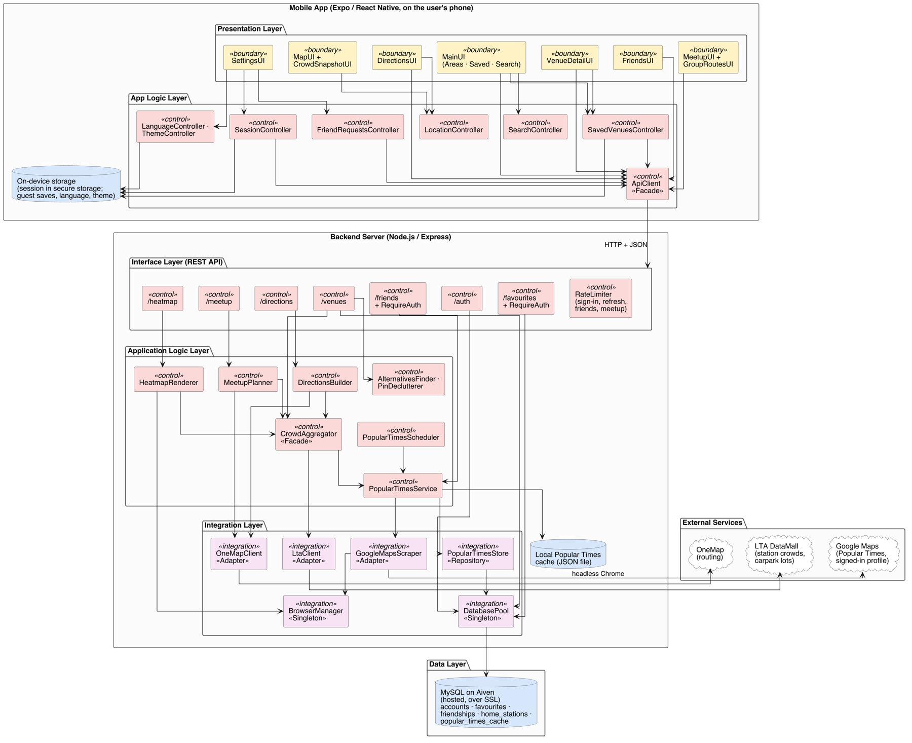



Layered architecture
DESIGN
App
Server
External Services
Database
Notes:
“Here’s our architecture. It’s a client and server design, built in layers.”
“In the app, the screens are boundary classes. They call controller classes, and only one class, ApiClient, ever talks to the server.”
“On the server, every request goes through routes, then the application logic, then one adapter for each external service: LTA, Google, OneMap, and our MySQL database on Aiven.”
“This keeps issues separate and coupling low. For example, during early developments, when we replaced our data from carpark-based crowd estimate with Google Popular Times, not a part in the app or frontend had to change.”
“This is the Open/Closed principle. A new data source is a new adapter, and the rest of the system doesn’t change.”

Slide 4
Every venue, coloured by how busy it is
FEATURE · LIVE CROWD MAP
The Right now card counts quiet, moderate and busy places and names the quietest mall near you.
Facade
CrowdAggregator merges all three sources into one venue list
Abstraction
Malls and stations share one Venue type, so every screen treats them alike
Fail-safe design
If a source fails, its last good data is kept, so the map never goes blank
Notes:
“This is the home screen."
“The heatmap makes busy places glow. It’s drawn on the server and changes every five minutes.”
"The Right now card sums up how many places are quiet, moderate or busy, with the quietest mall near you.”
"At the time of recording, it is 7.40pm and most places are crowded as everyone may be visiting malls for dinner together"
“Behind it, the server’s CrowdAggregator is a Facade. It merges all three sources into one venue list. Malls and stations are abstracted to share one Venue type, so every screen treats them the same way.”
“It’s also fail-safe. If a source fails, we keep serving its last good data instead of showing a blank map.”
“The heatmap makes busy places glow. It’s drawn on the server and changes every five minutes.”
“When I tap a mall, its card expands in place and there are more details about it.”

Slide 5
Typical crowds and quieter alternatives
FEATURE · VENUE PAGE
The crowd for this hour, labelled as typical, the usual week as a chart, opening hours, and up to three quieter malls within 3 km.
Single responsibility
AlternativesFinder has one job: choosing the alternatives
Black-box testing
13 cases from equivalence classes and boundary values
Shared data cache
One shared copy of the collected data, with a local backup
Notes:
“Opening a mall shows its crowd for this hour. Below that is the mall's usual crowd in a week as a chart, its opening hours, and up to three quieter malls of the same type within 3 km.”
“These comes from AlternativesFinder, a control class with a single job. We tested it with black-box testing: 13 cases from equivalence classes and boundary values.”
“And all of this crowd data comes from one shared copy in our database. Every teammate’s backend reads it instead of collecting from Google separately.”

Slide 6
Directions and search
FEATURE · GETTING THERE
Routes in four modes with the live crowd at each station you board, and search that forgives a one-letter typo.
Adapter
OneMapClient turns OneMap’s format into our own route types
Reuse
Route crowd levels reuse the map’s live station data
Basis path testing (white-box tested)
Search matching (tokenHits) has complexity 6, so 6 test paths
Notes:
“From here, pressing on Directions draws a route on our own map"
"You can view the exact route details and there are route options for transit, walking, driving, and cycling."
“So our OneMapClient is an Adapter. It turns OneMap’s format into our own route types, so nothing else in the system depends on OneMap.”
“The crowd shown at each station isn’t fetched again. It reuses the live station data the map already has.”
“And search finds a venue by name, address or postal code, even with a one-letter typo in a longer word. Its matching method, tokenHits, was white-box tested with basis path testing. Its cyclomatic complexity is six, so we tested six independent paths.”

Slide 7
Saved places, friends and security
FEATURE · ACCOUNTS AND FRIENDS
Save places as a guest or to an account. Crowdy asks before adding a guest’s saves, and alerts you to friend requests.
Security
bcrypt password hashes, signed sessions, rate limiting per client
No hints to attackers
A wrong username and a wrong password get the same message
Observer
When friend requests change, every badge updates by itself
Notes:
“Anyone can save places as a guest. With an account, your saves sync across phones."
“For security, passwords are stored only as bcrypt hashes, sessions are signed tokens that expire after 30 days."
"The wrong username or a wrong password gets the same message, so attackers can’t tell which accounts exist.”
"When a guest signs in, Crowdy also asks before adding their saves, so one person’s saves never leak into another account on a shared phone.”
“When a friend request arrives, an alert appears, and every badge updates through the Observer pattern.”
"A logged-in user can view their friend requests in the friends list as well."
"And now, ION Orchard is a saved venue along with other saved venues that existed before in user_1’s account."

Slide 8
A fair mall for the whole group
FEATURE · MEETUP PLANNER
For 2 to 6 people, now or at a chosen time in the next week, ranked by fairness, total travel time or crowd.
Clear ranking rules
Least crowded only picks malls that stay close for everyone
Performance by design
Shortlist first, at most 8 route lookups at once, trips cached 6 hours
Tested
11 automated tests cover each priority and chosen times
Notes:
“The meetup planner is an another feature. For up to 6 people, the user can add themselves, their friends in the app, and even non-users of Crowdy to get recommended places to hangout based on fair travel times, shortest average trip or even least crowded malls”
"You can even plan ahead of time for future hangouts sessions.”
“To keep performance fast, we shortlist malls by distance first, run at most eight route lookups at once, and cache the trips for six hours.”
“Then everyone can see their own route.”
"Now, let us plan ahead for 9pm later in the day to see the change in recommended places."
“Planning ahead uses each mall’s usual crowd and the train and bus timetable at that time, and everyone can choose to arrive by or leave at the meeting time.”

Slide 9
Testing, traceability and workflow
ENGINEERING · QUALITY
50
24
0
server tests, all passing
app tests, all passing
critical security findings
Traceability
Requirement, use case, design class, code and tests all link up
Git workflow
Work on dev, reviewed feature branches, main is what we submit
Notes:
“For quality assurance, we have 50 automated server tests and 24 app tests, all passing, including our black-box and white-box basis path cases. A Scantist security scan found no critical issues.”
“And the whole app works in English and Chinese, in dark mode or light mode.”
“Every requirement in our SRS traces to a use case, a design class, the code and its tests.”
“We worked in Git. Features go on a dev branch, teammates’ branches are reviewed before merging, and main holds the final updated version. Key classes and public methods are documented with JSDoc.”

Slide 10
Thank you
SCSJ Group 3 · SC2006 Software Engineering · Crowdy
Notes:
“That is all from us, hope you've enjoyed the idea and design of Crowdy and thanks for watching.”

